Slide 1
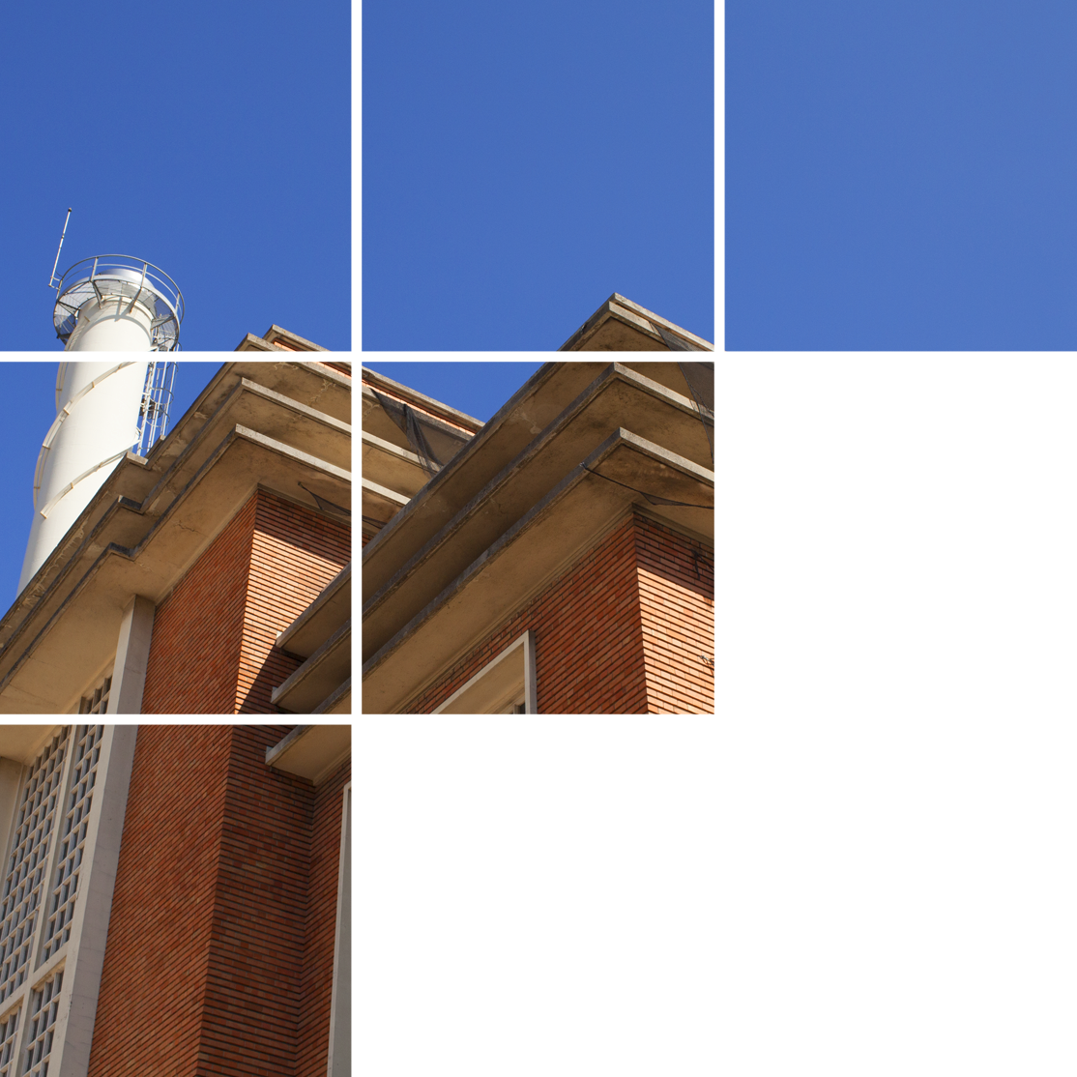

OPEN CALL
APOLAN RESIDENCY
FONDATION FIMINCO
Application deadline: March 29, 2026
midnight
(CET)

Slide 2
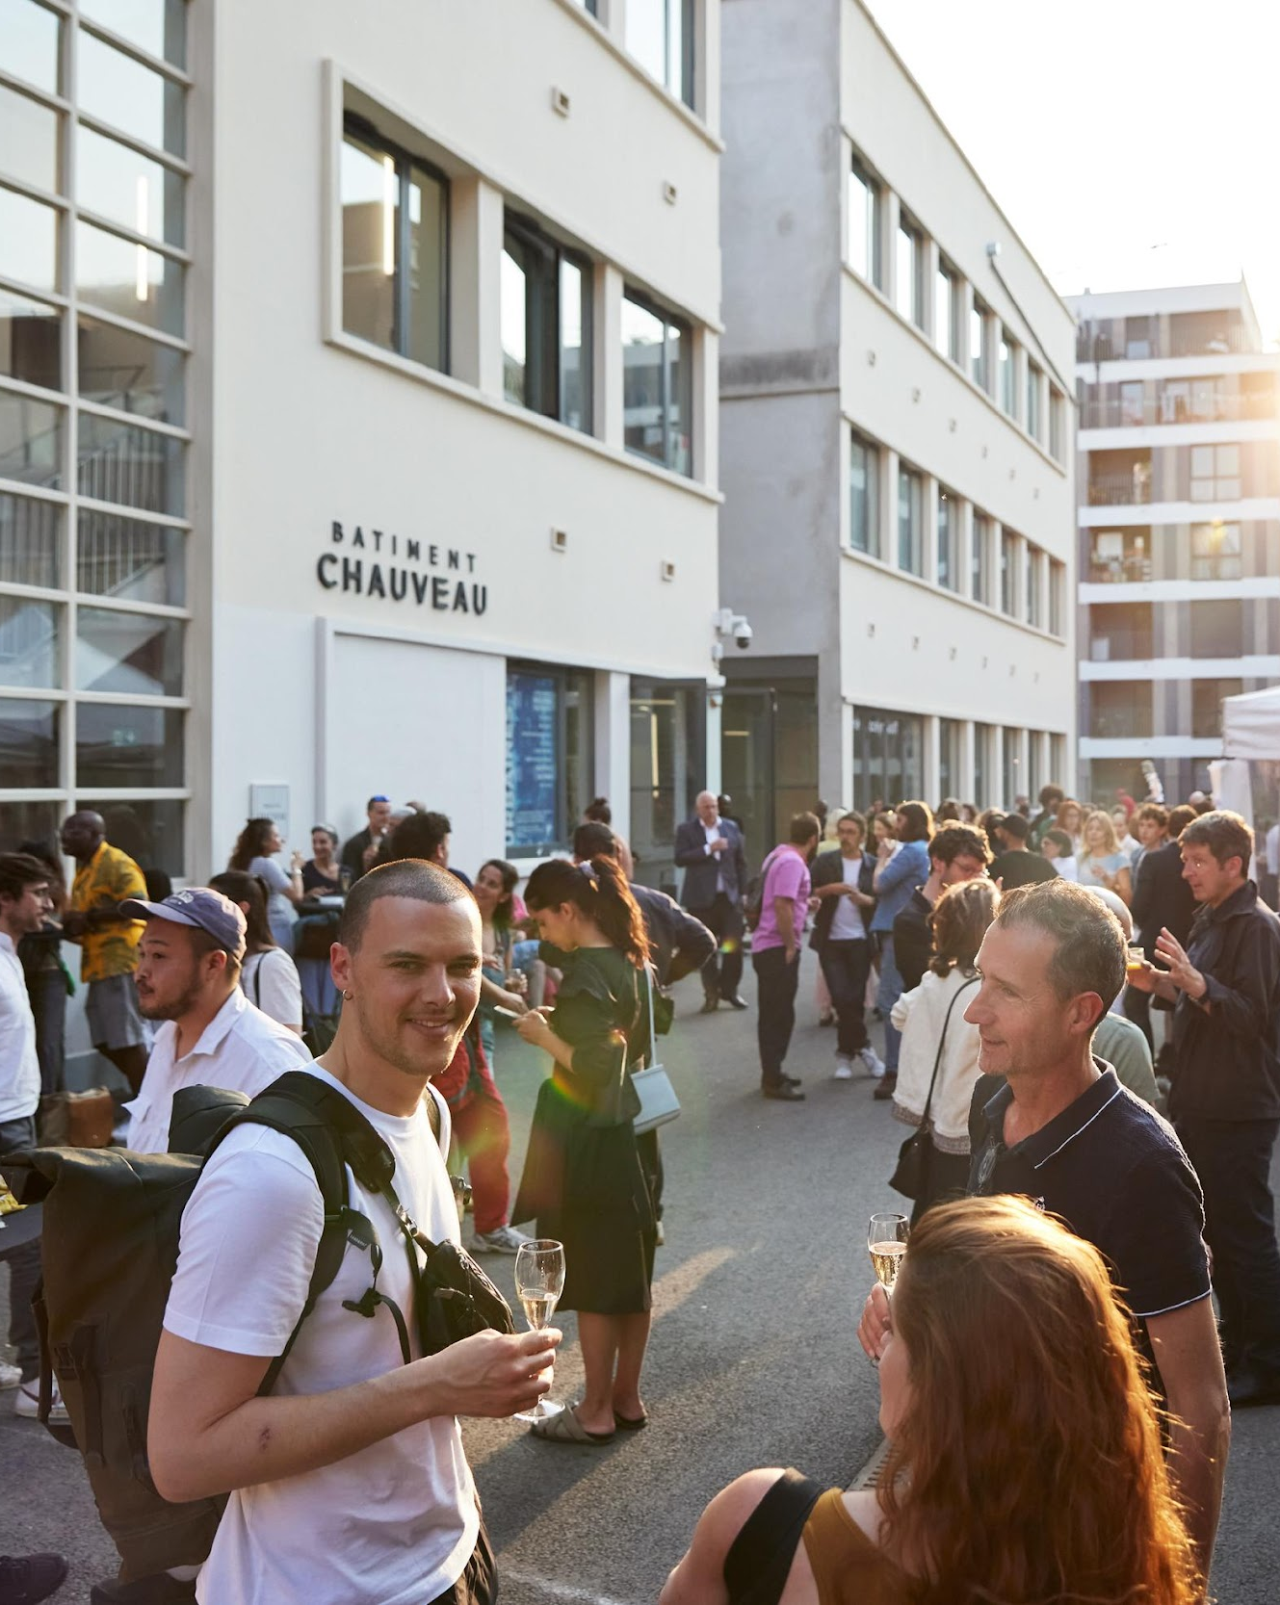
OPEN CALL FOR TAIWANESE ARTISTS ———————————— FONDATION FIMINCO
APPLICATION PROCEDURE
In partnership with the Taiwan Cultural Centre in Paris, on behalf of the Ministry of Culture, Taiwan (R.O.C.), the Fondation Fiminco welcomes applications from Taiwanese artists for a 4-month research, creation and production residency in Romainville (Seine-Saint-Denis) from mid-September 2026 to mid-January 2027.
The name of this residency programme "APOLAN" is a mandarin pronunciation of "阿婆蘭", an unique native specie of Phalaenopsis amabilis in Taiwan.The name represents what we believe in culture, that focuses on uniqueness, originality and blossoms as flowers, which we will like to share with the world.
WHO CAN APPLY?
Taiwanese artists of any age, focused on new media and digital art, with an established professional career.
SELECTION PROCESS
A jury composed of professionals from the culture and arts sector, as well as representatives of the Fondation Fiminco and the Taiwan Cultural Center in Paris, will make a shortlist of candidates based on their application. The shortlisted artists will then be invited for an interview (via videoconference) at the end of March 2026.
CALENDAR
Application deadline
March 29, 2026, midnight (CET)
Jury and interviews with shortlisted candidate
17th of April 2026
Announcement of the selected candidate
End of April 2026
Beginning of the residency
Mid-September 2026
© Andreas B. Krueger, View of the exhibition opening Odyssées Urbaines, 2023

Slide 3
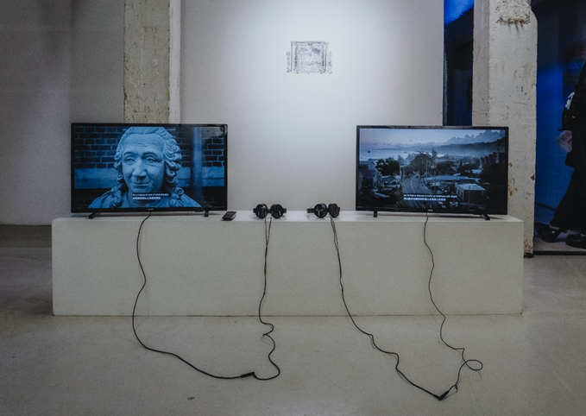

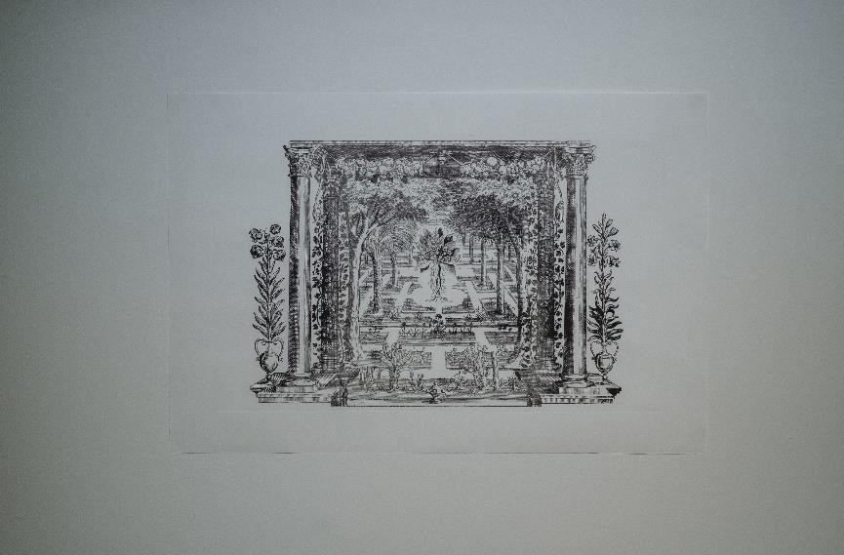
OPEN CALL FOR TAIWANESE ARTISTS ———————————— FONDATION FIMINCO
APPLICATION FILE
Applications can be written either in French and Mandarin or English and Mandarin and submitted via the online form before March 24, 2026, at midnight, CET.
For your online application, a Google account is required.
Please arrange your documents in the following order:
MANDATORY DOCUMENTS
(If the application does not contain these elements, it will not be considered)
1/ CV in which candidates should mention their educational and professional background.
(2 pages maximum)
2/ A letter of intent presenting the research project and program ideas that candidates wish to explore during the 4-month residency.
(2 pages maximum)
3/ A portfolio of recent works representative
of the artist’s approach (5 pages maximum)
4/ One or more letters of recommendation addressed to the jury, supporting the candidate.
(3 letters maximum)
OPTIONAL DOCUMENTS
5/ Publications, videos, etc. any other resources the artist deems useful to bring to the attention of the pre-selection committee (participation in conferences or symposiums, press articles, films, interviews, etc.)
Please CLICK HERE
to apply !
© Manuel Abella, Views of the exhibition TALENTS! Farewell, 2023 Artist – Yu Liu
© Manuel Abella, Views of the exhibition TALENTS! Farewell, 2023
Artist – Yu Liu

Slide 4
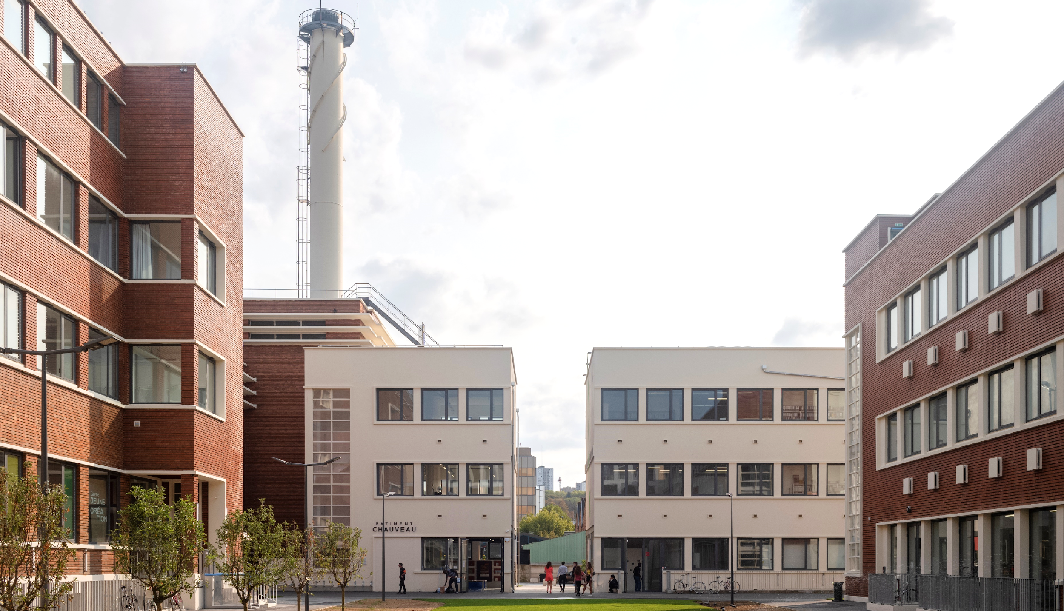
THE RESIDENCY OF THE FONDATION
FIMINCO
© Martin Argyroglo

Slide 5
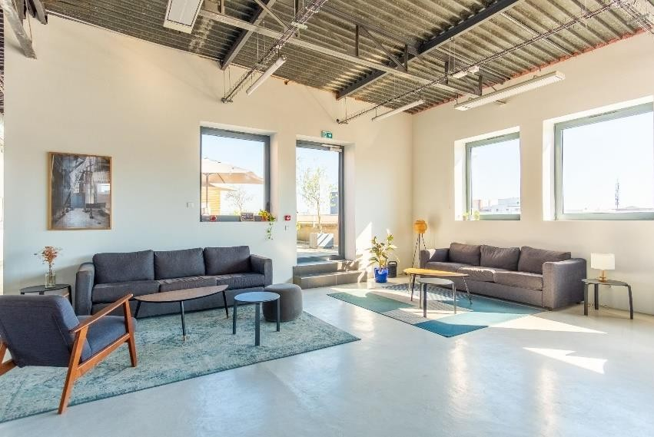
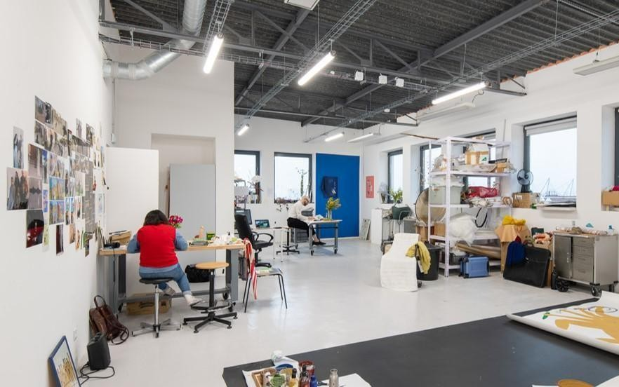
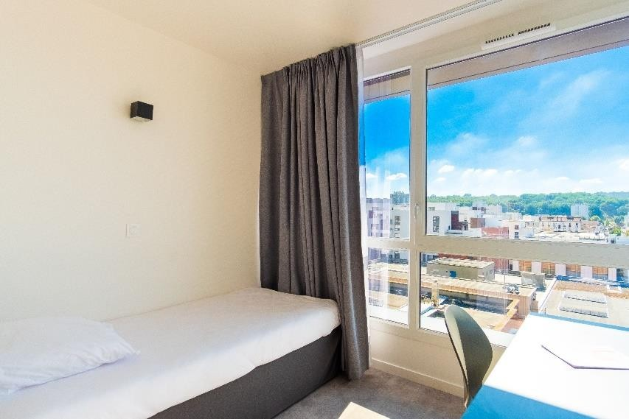
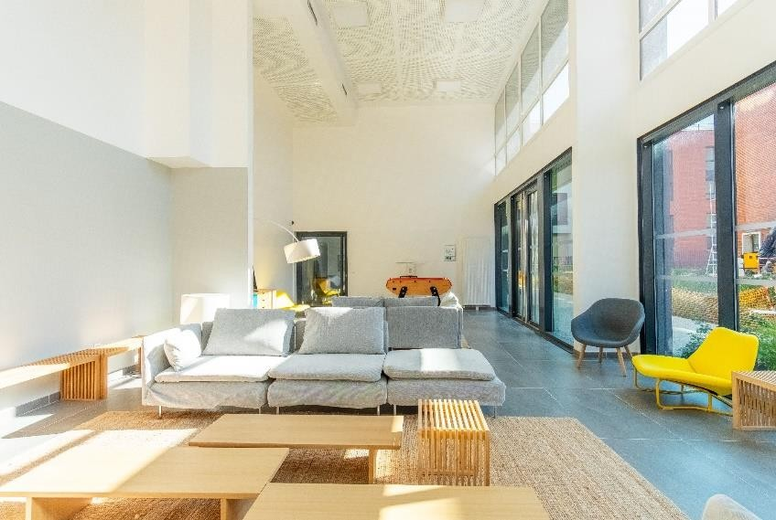
RESIDENCY CONDITIONS
OPEN CALL FOR TAIWANESE ARTISTS ———————————— FONDATION FIMINCO
ACCOMMODATION
Each resident artist has a furnished studio with a private bathroom and a private equipped kitchenette. Common living areas are also available to residents, including shared lounges areas and a terrace
On the arrival and departure of the artist, a joint inventory of fixtures is carried out. Residents undertake to use the various premises at their disposal in a peaceful manner, maintaining them in good condition, and to report any problems observed. The Fondation Fiminco residency’s accommodation is non-smoking and cannot accommodate pets.
COLLECTIVE WORKSHOPS
Each resident artist has their own workspace in bright, spacious collective studios, equipped with furniture and storage. Shared between 2 and 4 artists, offering each artist a dedicated workspace.
© Manuel Abella/ common lounge area
© Martin Argyroglo
© Manuel Abella / bedroom
© Manuel Abella/ common lounge area

Slide 6
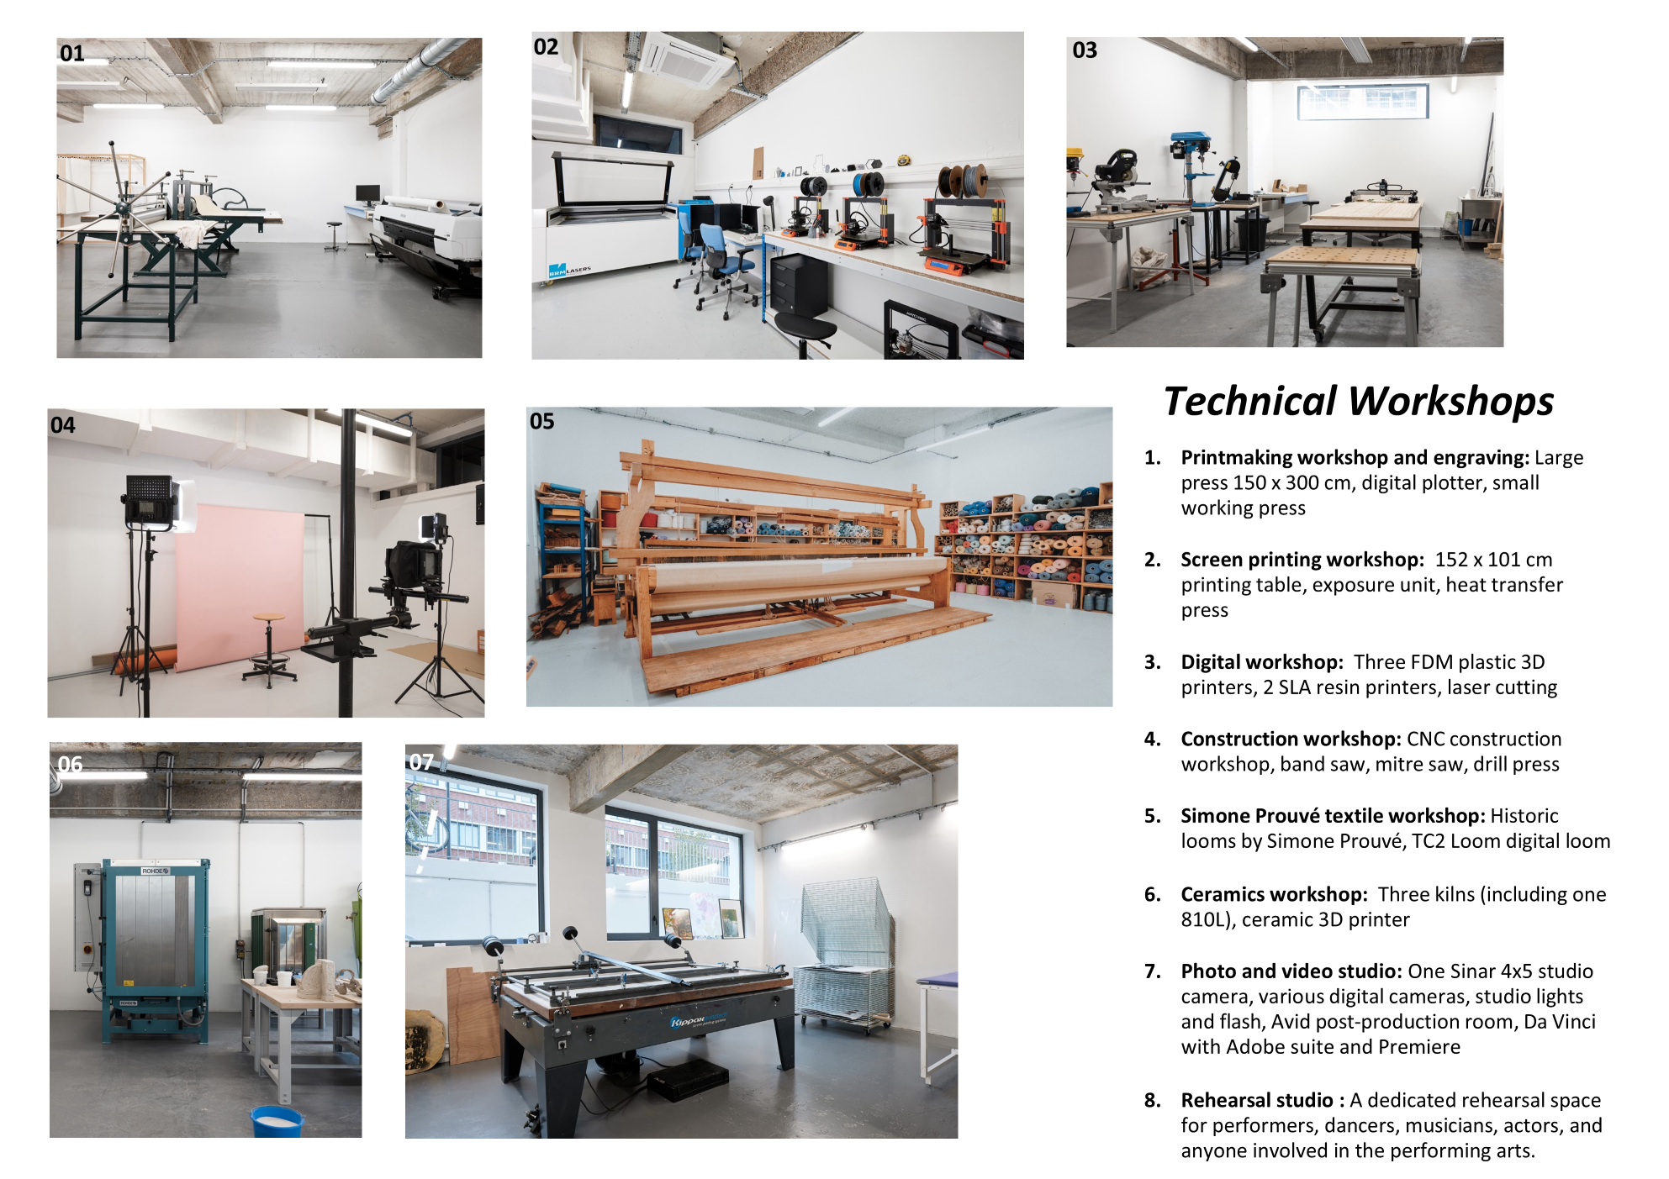
TECHNICAL WORKSHOPS
OPEN CALL FOR TAIWANESE ARTISTS ———————————— FONDATION FIMINCO
Residents have access to a broad range of production studios that are constantly being developed and extended by the Fondation according to the evolution of the residency and its needs. Workshop leaders regularly accompany the residents in expanding their artistic practice.

Slide 7
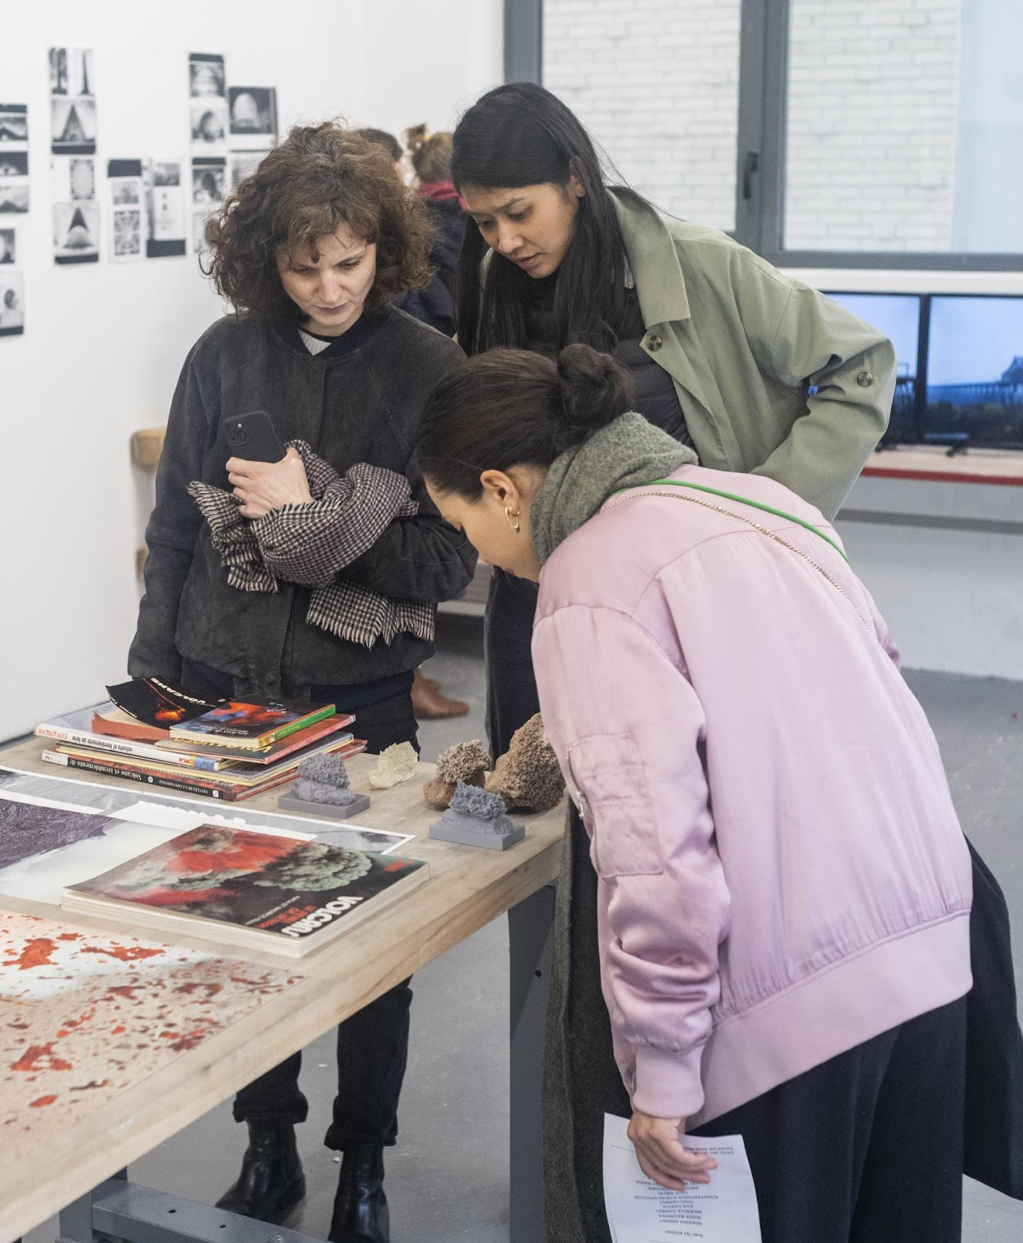
OPEN CALL FOR TAIWANESE ARTISTS ———————————— FONDATION FIMINCO
SUPPORT FOR ARTISTS IN RESIDENCE
ACCOMMODATION
The artist will be housed in a furnished studio with a private bathroom and a kitchenette (between 20 and 25 square meters). She/he will also have access to communal living areas.
WORKSHOPS
The artist will have a workspace in spacious collective
studios and access to well-equipped technical
workshops (engraving, silk-screening, ceramics, 3D
printing, construction, textile, photo and video).
ADMINISTRATIVE SUPPORT
The Fondation Fiminco with the Taiwan Cultural Centre in Paris offers support regarding any administrative formalities, such as visa applications, and can also help with the search for additional grants.
PROFESSIONAL SUPPORT
The resident will receive professional support according to their needs and in line with the project they wish to develop technical assistance for production, distribution, and communication.
GRANT FOR LIVING EXPENSES AND ARTISTIC PRODUCTION
The Taiwanese Ministry of Culture will grant the artist with a residence allowance of 305,000 NTD (equivalent to approximately 9,000 euro VAT), which includes round-trip ticket, living cost, production fee, insurance, visa application fee, SIM card...
The artist has to submit a separate application for the grant to the Ministry of Culture once they are selected.
© Martin Argyroglo

Slide 8
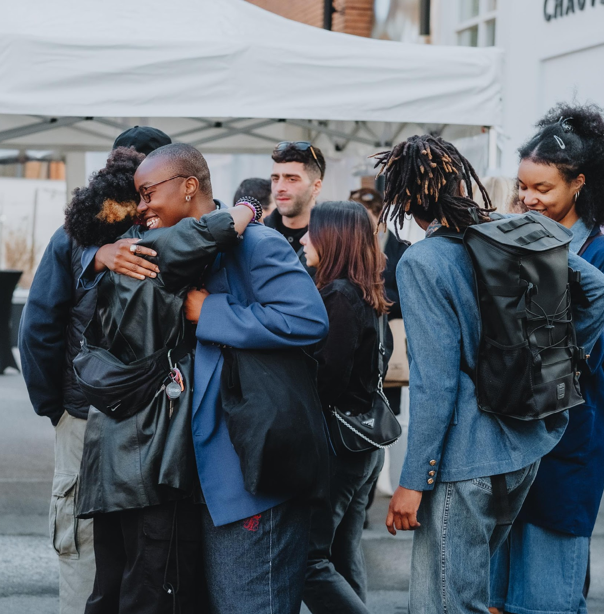
OPEN CALL FOR TAIWANESE ARTISTS ———————————— FONDATION FIMINCO
ARTISTIC AND CURATORIAL MENTORSHIP AND PROFESSIONALIZATION
WORKING WITH THE LOCAL COMMUNITIES
AND MEETING THE AUDIENCE
The primary objective of the residency is to provide artists with the ideal setting for their research and creative work.
The Fondation Fiminco’s residency is a place of professionalization that helps artists gain visibility on the French art scene and become part of a network.
To this end, the foundation organizes meetings
with professionals from the art world: curators, collectors, gallery owners, friends of the museum groups, journalists, and art critics. Open studios are also organized, allowing the public to discover the residents’ studios and creative spaces over an entire day.
The foundation also offers cultural field trips to help residents discover new places and practices of contemporary creation in the Île-de-France region.
The artist will need to submit a report to the Ministry of Culture.
The Fondation Fiminco organizes a variety of events (exhibitions, performances, conferences, art history courses....) throughout the year, all free of charge and open to all members of the public.
Designed as a place to increase awareness of contemporary art, open to its environment, all residents are encouraged to develop interactions with visitors. As a true local stakeholder, the Foundation develops partnerships with cultural institutions, local authorities, schools, and associations, to carry out educational, artistic, and cultural projects for audiences far removed from culture.
Considering the importance, the Fiminco Fondation attaches to transmission and mediation, particularly with young audiences, the artists’ engagement is highly desired and appreciated.
© Manuel Abella, View of the exhibition opening, Gunaikeîon 40 ans du Frac, 2023

Slide 9
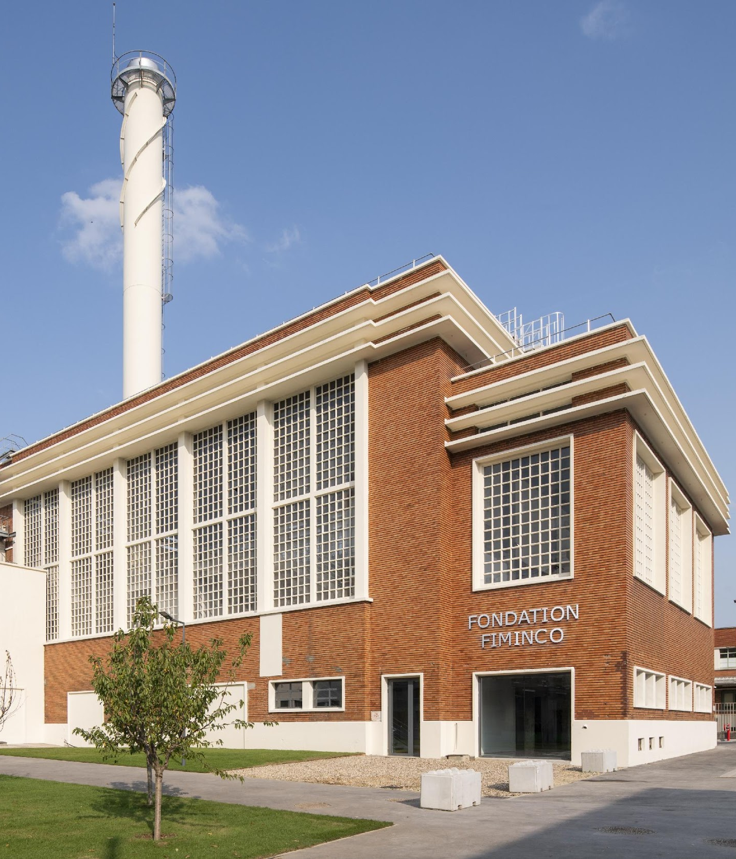
OPEN CALL FOR TAIWANESE ARTISTS ———————————— FONDATION FIMINCO
PRESENTATION OF THE FONDATION FIMINCO
The Fondation has rehabilitated a former industrial site on the outskirts of Paris (Romainville) to make it a resource centre for international artists and curators. This unique site brings together Fondation Fiminco’s international artists and curator’s residency, exhibition spaces and seven art galleries – Air de Paris, , In Situ Fabienne Leclerc, Iragui Gallery, Nika project Space, Quai 36 and 22,48 m2 the audiovisual production company Gingerlemon, the art and design school Parsons Paris, the Laurel Parker book design and publishing company, the lightning design company Minuit Une and the virtual reality production studio Lucid Realities, and the reserves of the Frac Île-de-France. The site also hosts the dance studio of the Compagnie Blanca Li.
Inaugurated in 2019, the Fondation Fiminco hosts international artist residencies and a voluntarily eclectic program of events, featuring exhibitions, concerts, dance performances, theater, post-residency presentations, film shootings and screenings, seminars, conferences and other professional events. Programs at the Fondation Fiminco are open to all audiences.
The Fondation Fiminco's mission is to support artists of all disciplines at every stage of their creative journey by encouraging their individual development and their integration into professional networks, both in France and internationally. No reciprocal obligations are required.
© Martin Argyroglo

Slide 10
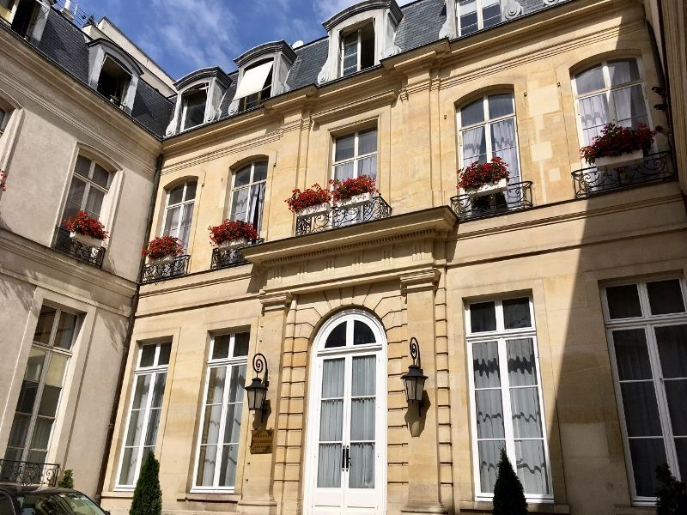
OPEN CALL FOR TAIWANESE ARTISTS ———————————— FONDATION FIMINCO
PRESENTATION OF TAIWAN CULTURAL CENTER TO PARIS
The Taiwan Cultural Center, established by the Ministry of Culture at the Taipei Representative Office in France, is the first Taiwanese cultural organization to be set up in Europe. Located in the heart of Paris, next to Musée d'Orsay.
Its aim is to promote exchange programs, artistic and cultural cooperation between Taiwan and France, as well as with other European countries, based on the universal values expressed in Taiwanese arts and culture.
These initiatives, which are aimed at artists and professionals in the arts and culture sectors, as well as the general public, are designed to raise the profile of Taiwanese culture and encourage the development of the cultural economy, including through new media and the Internet.

Slide 11
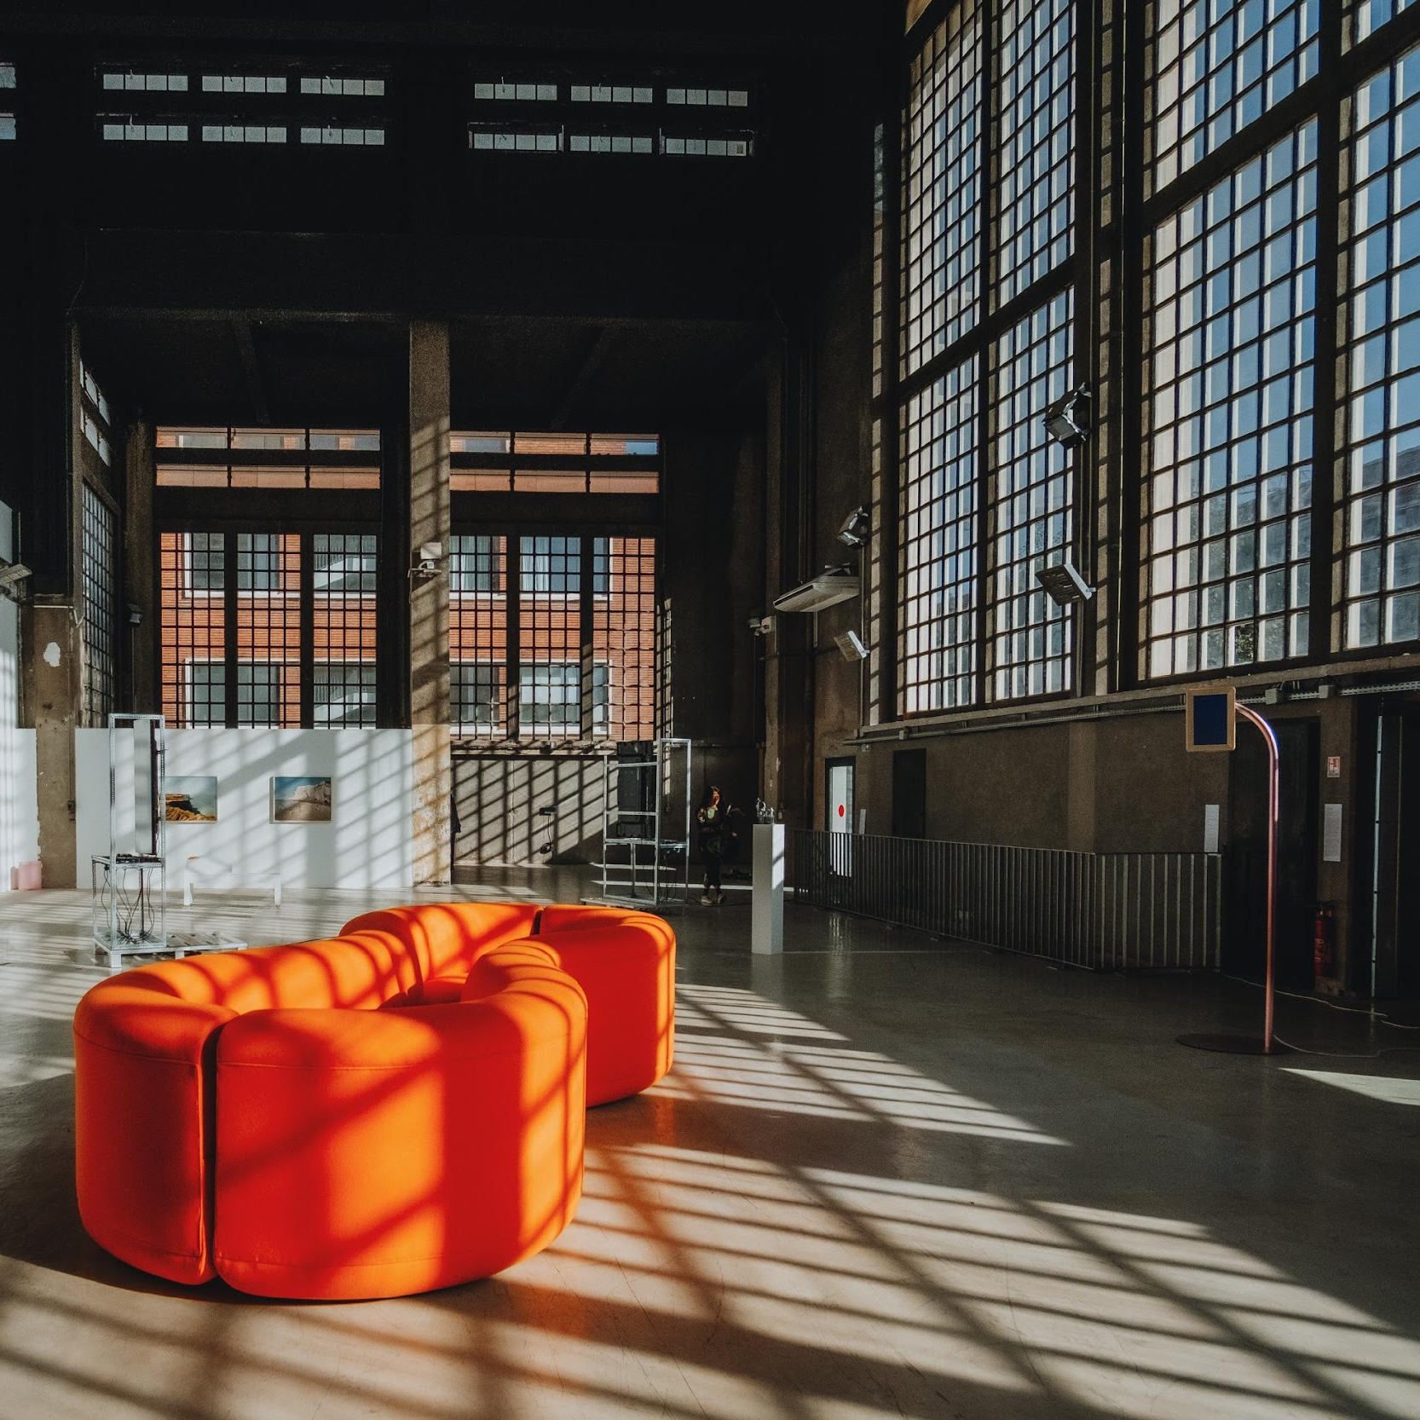






Fondation
Fiminco
43 rue de la Commune de Paris
93230 Romainville
France
www.fondationfiminco.com
78, rue de l’Université
75007 Paris
France
https://fr.taiwan.culture.tw/
@fondationfiminco
@centrecultureldetaiwan
—— CLICK HERE
TO APPLY ———
@fondationfiminco
@centrecultureldetaiwan
@fondationfiminco
@centrecultureldetaiwan
@ffiminco
@ccacctp
© Manuel Abella, View of the exhibition Gunaikeîon 40 ans du Frac, 2023
@fondationfiminco

